Slide 1
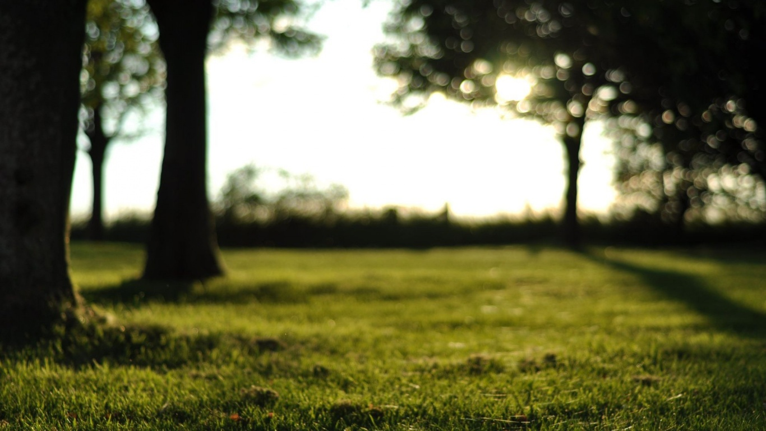
Health Short-sightedness POVs and Experience Prototypes
承洋、際禎、凱捷、George、Wei Yang

Slide 2

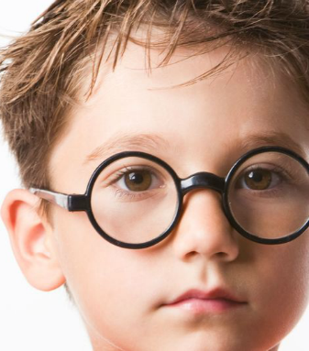
Initial POV from previous assignment
We met people of different ages.
We were amazed to realise that all of them developed short-sightedness when they were young.
It would be game-changing to find a way to tackle short-sightedness at a young age.

Slide 3

Interviewee 1 - Parent
Worried about children’s eyesight
Children spend long hours studying or using electronic devices
Feels there is no alternative to getting an education without studying hard
Contradiction between caring for child’s eyes and caring for child’s future.

Slide 4
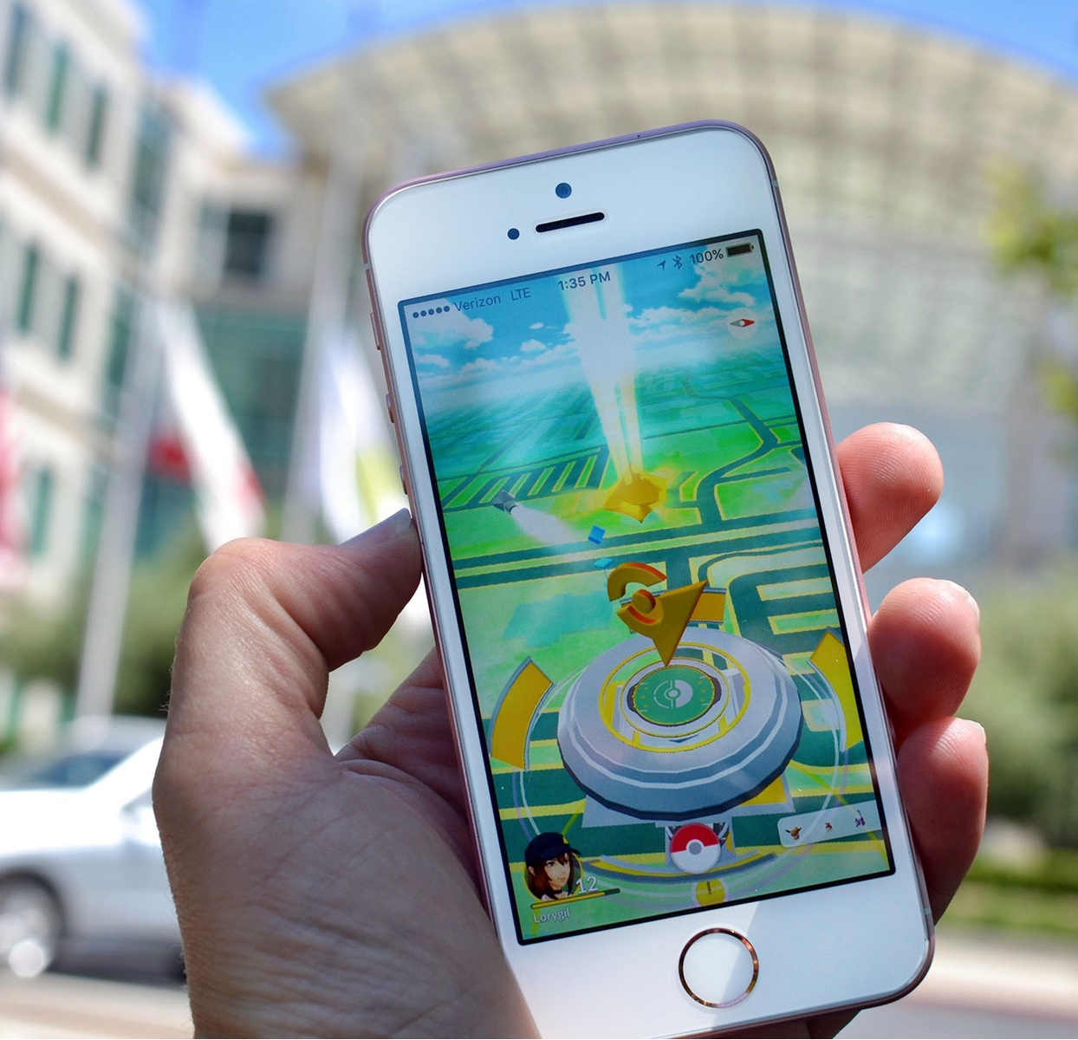
Interviewee 2 - Pokemon Go player
Influenced by many others to play the game
Gets to go out and walk around
Still stares at the screen a lot while playing
App is successful in getting people out of their house, but it doesn’t work in getting their eyes off the phone screen.

Slide 5
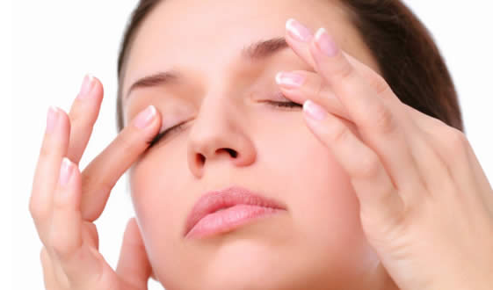
Revised POVs
Concerned parent seeks a way to take care of children’s eyesight to prevent them from getting short-sightedness.
Pokemon Go player seeks a way to rest eyes while still going out of the house to play.
Hardworking student seeks a way to maintain good eyesight while studying long hours.

Slide 6
Top 3 HMWs
POV | HMW
Concerned parent seeks a way to take care of children’s eyesight to prevent them from getting short-sightedness. | HMW help children develop the habit to take breaks and rest their eyes?

Slide 7
Top 3 HMWs
POV | HMW
Hardworking student seeks a way to maintain good eyesight while studying long hours. | HMW make studying involve less reading, mix with other methods so that kids put less stress on their eyes?

Slide 8
Top 3 HMWs
POV | HMW
Concerned parent seeks a way to take care of children’s eyesight to prevent them from getting short-sightedness. | HMW makes books/electronic devices less harmful to the eyes?
Hardworking student seeks a way to maintain good eyesight while studying long hours.
Pokemon Go player seeks a way to rest eyes while still going out of the house to play.

Slide 9
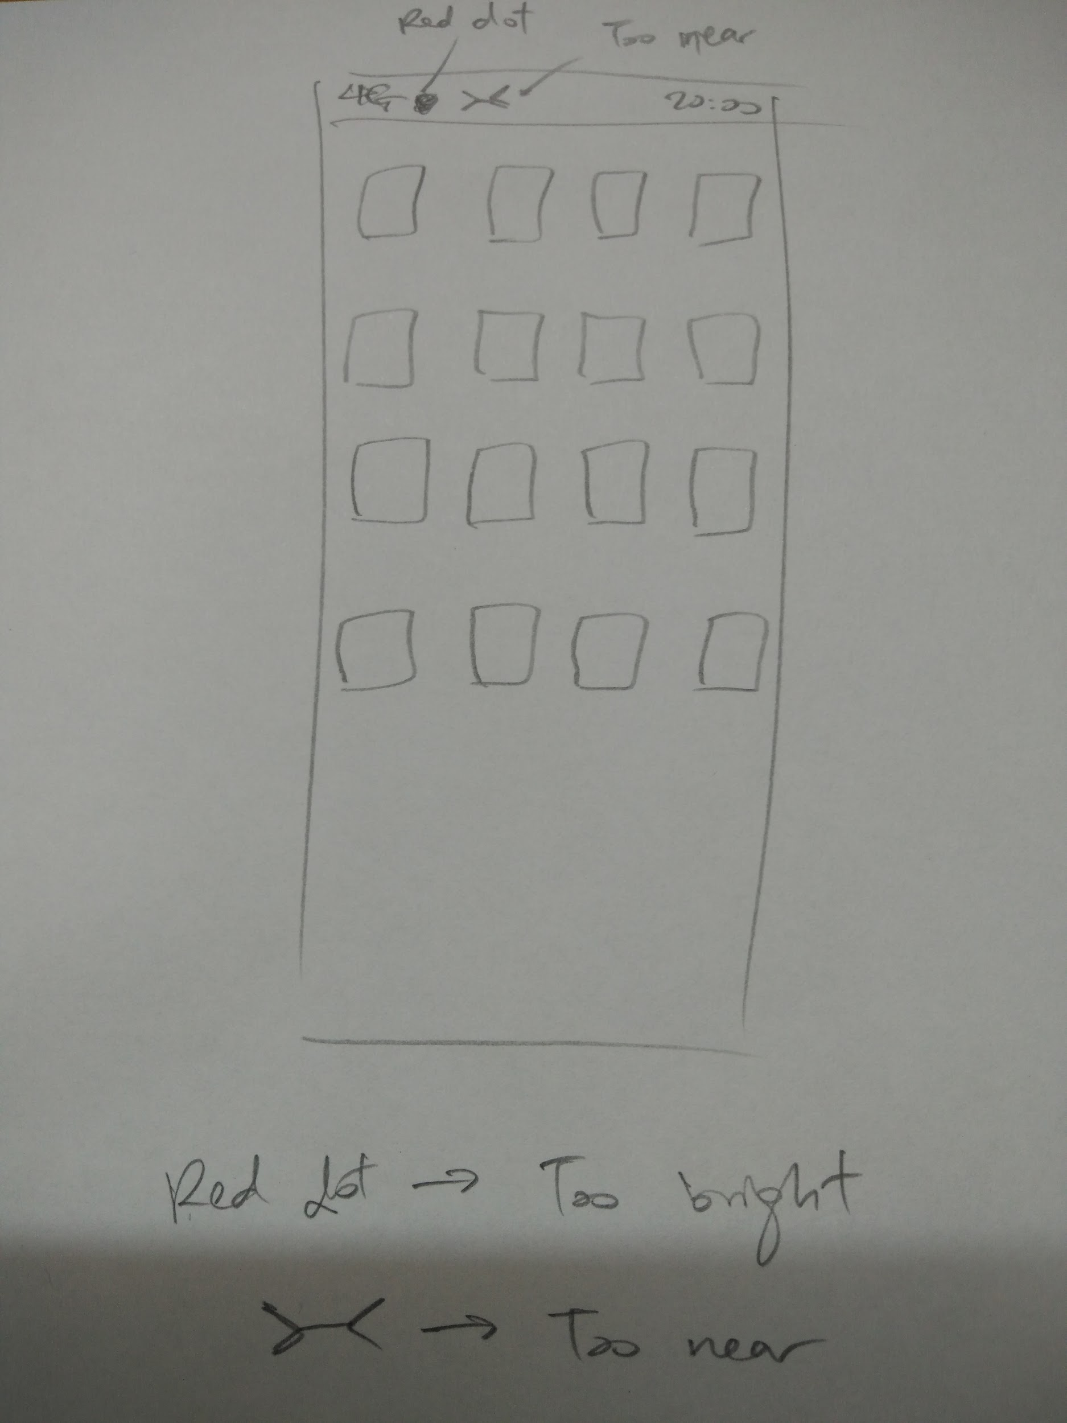
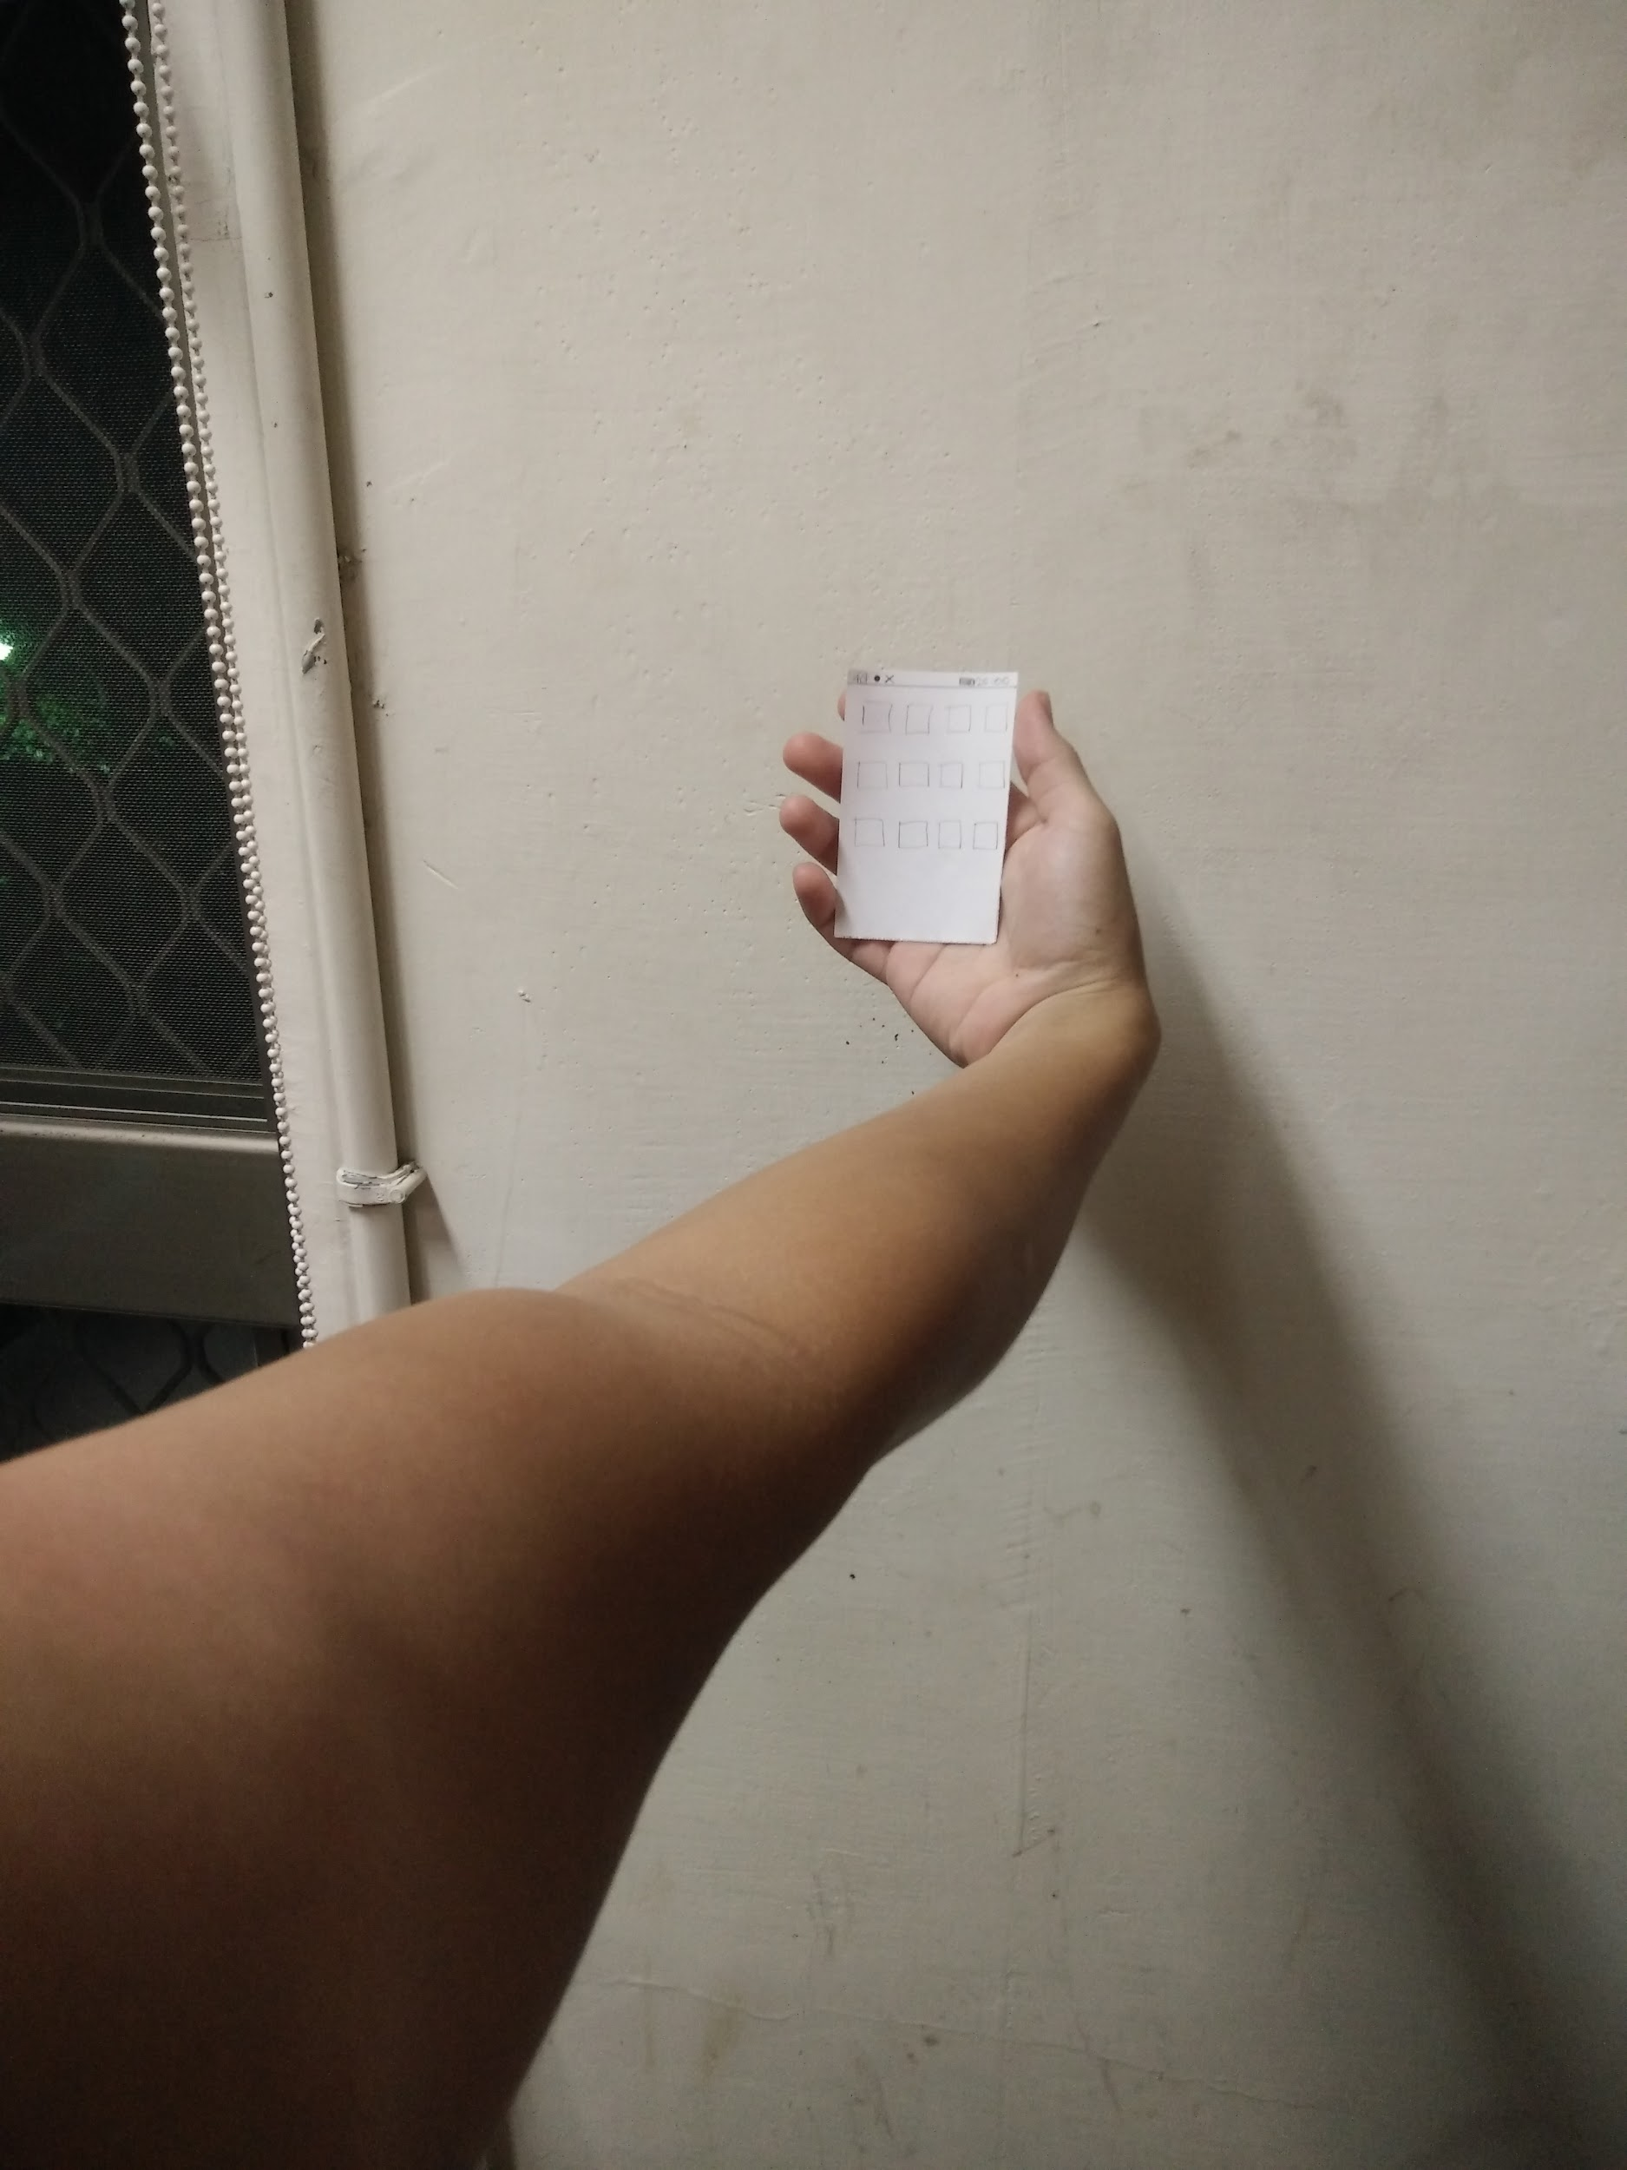
Prototype 1
Detect brightness and distance and recommend optimal settings
Easy for user to understand
Icons were not clear
May be difficult to see icons under bright light
Icons may not catch user’s attention

Slide 10
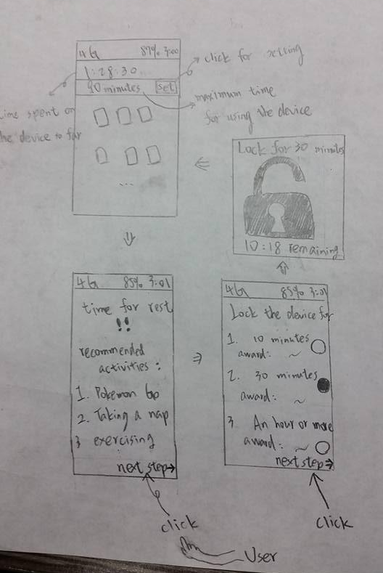
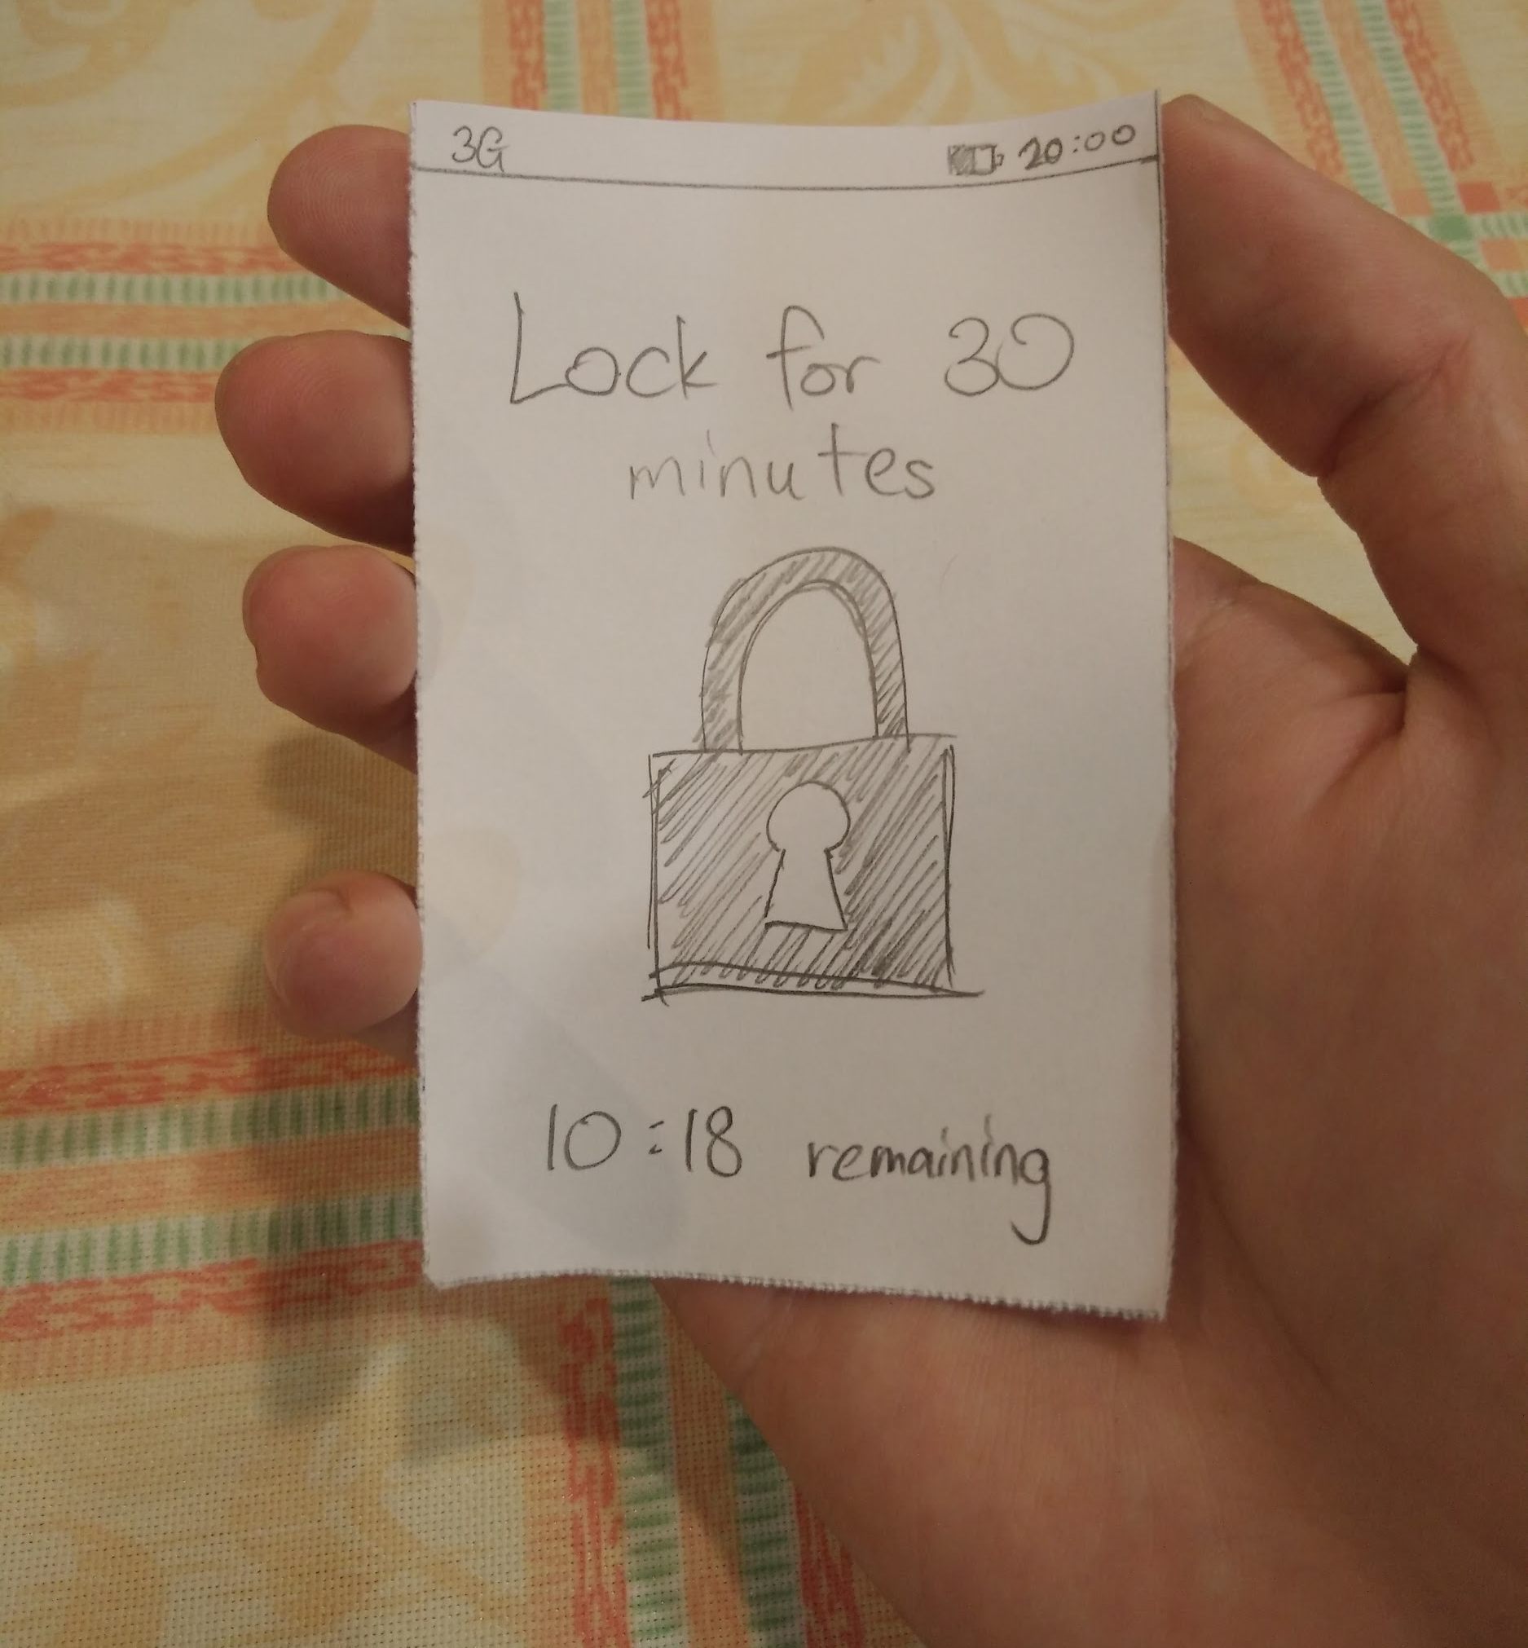
Prototype 2
Give rewards if children rest regularly, else phone gets locked
Lock screen is very clear
User can amend timing himself in settings
User may need to use phone urgently
Needs to be strict, but flexible too

Slide 11
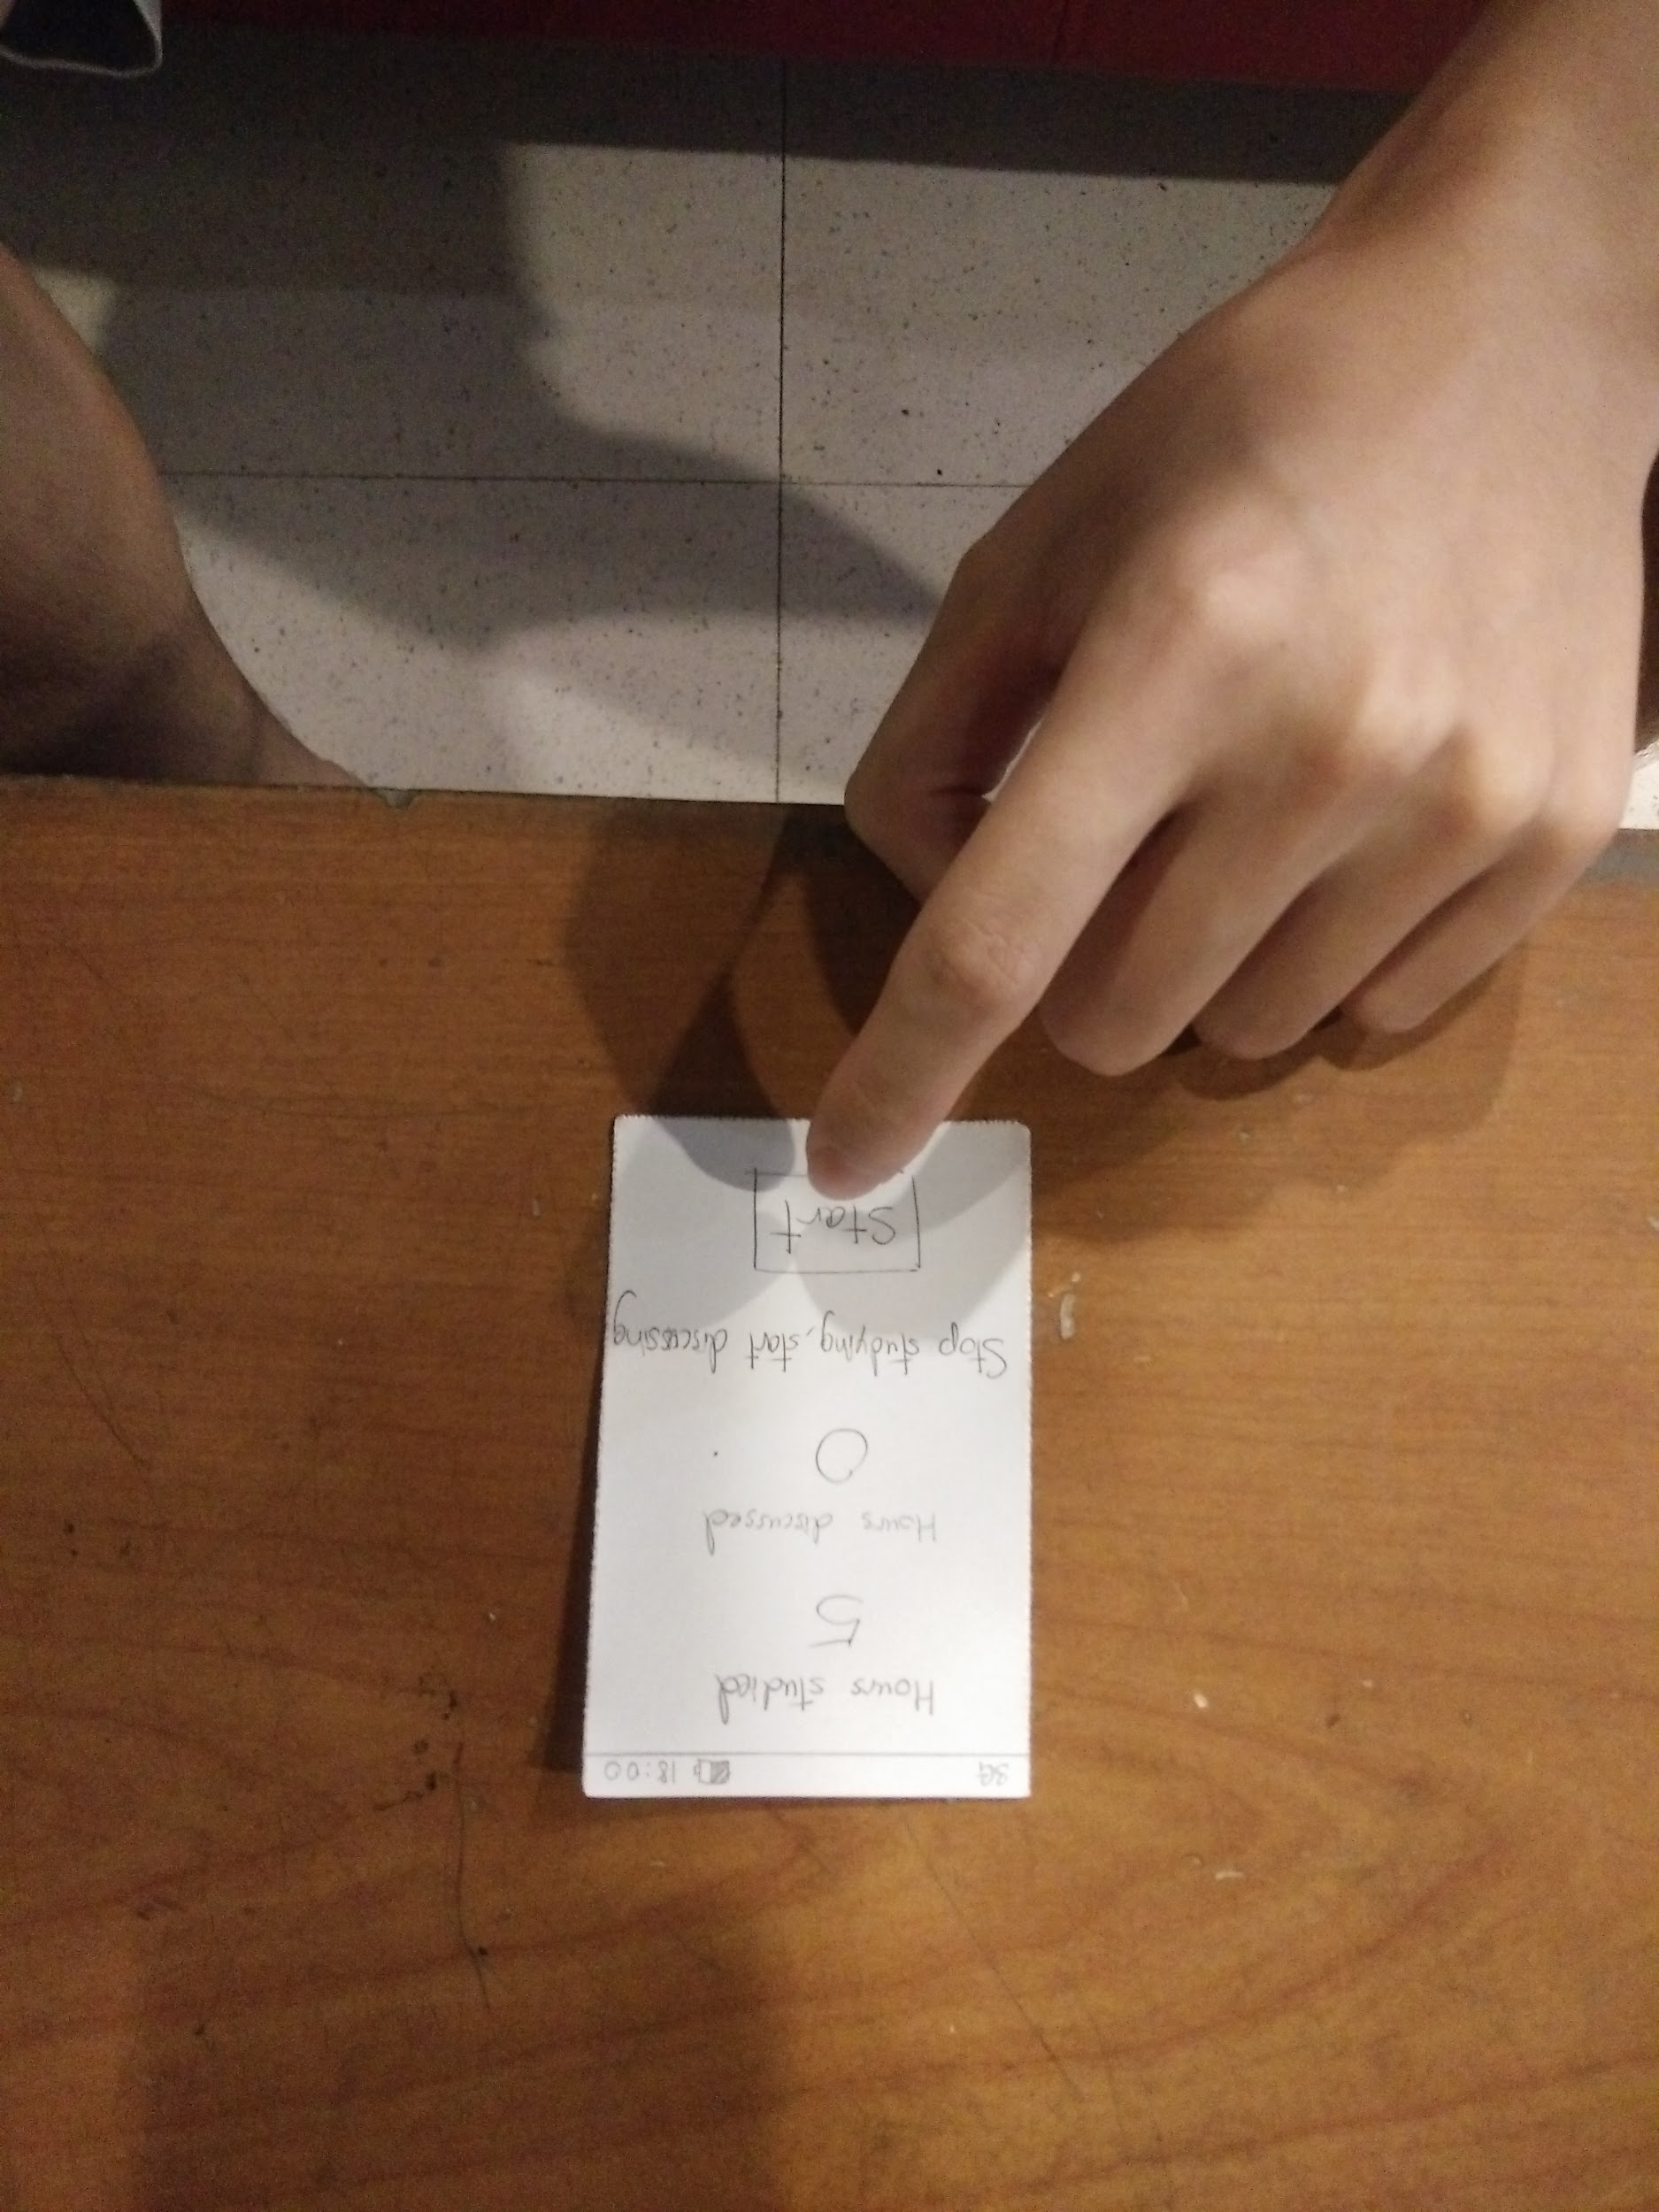
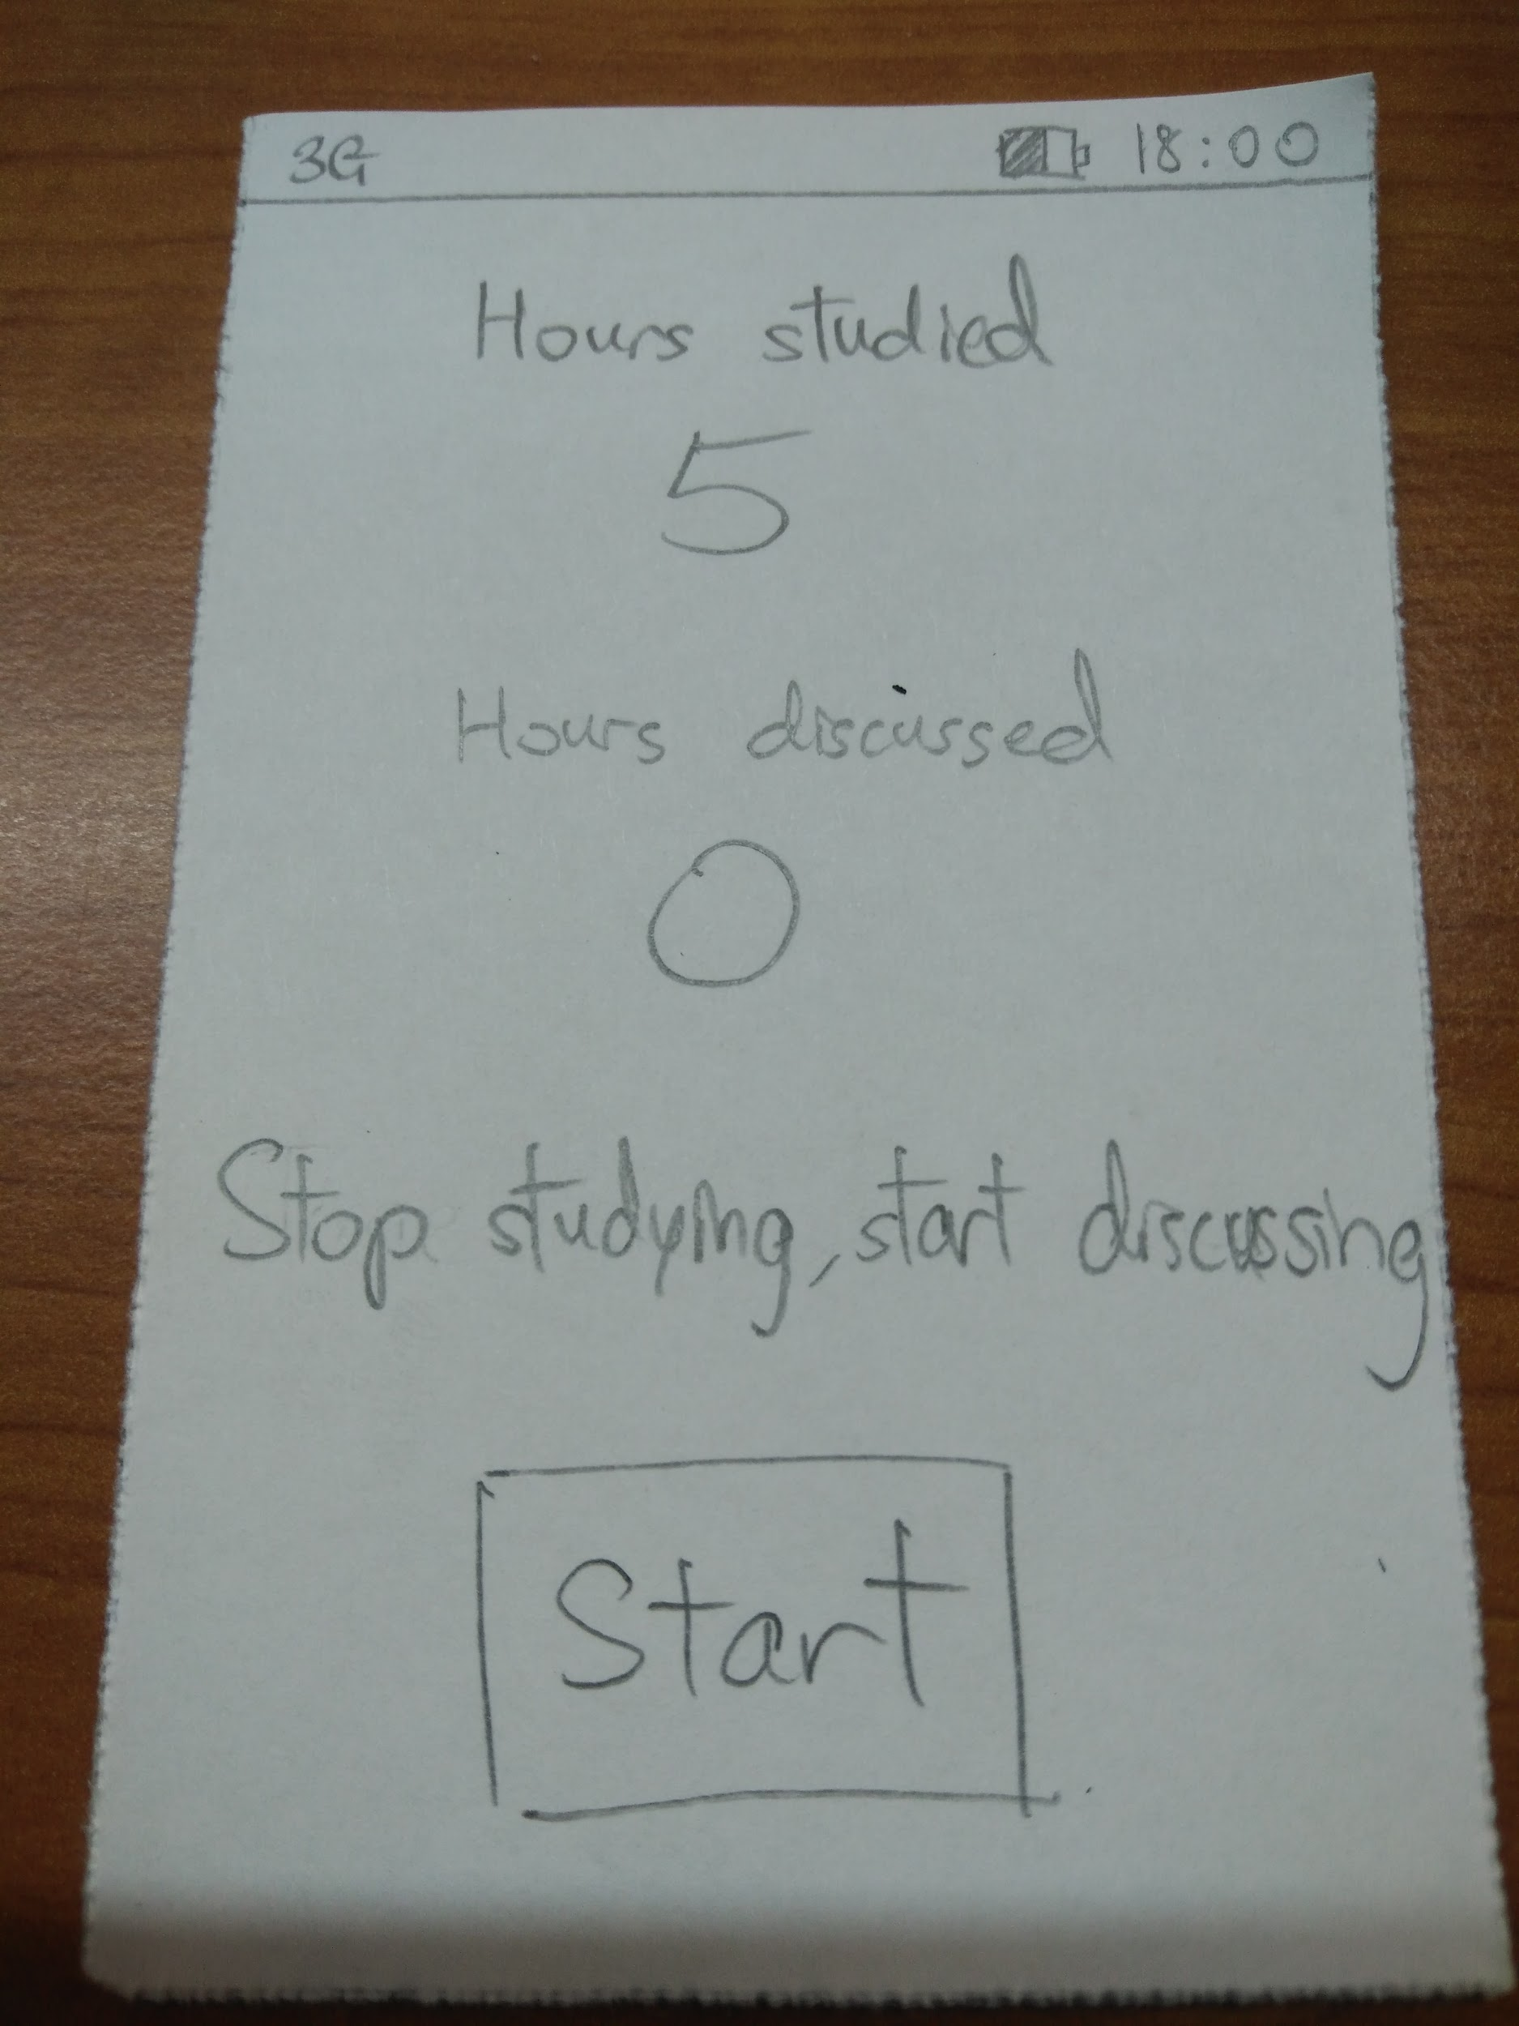
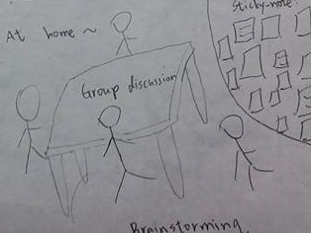
Prototype 3
Less reading, more discussion in studies
Information is shown clearly
User may not follow advise
Troublesome to use
May need some incentive for user to use

Slide 12
Thank you

